Slide 1
Multimedia Systems Lecture – 7
By
Dr. Priyambada Subudhi
Assistant Professor
IIIT Sri City

Slide 2
Digital Image Representation
The most common form to represent natural images and other forms of graphics that are rich in detail is bitmap.
The term bitmap refers to how a given pattern of bits maps to a specific color.
They store this information in a grid of points (array of points) or pixels, which has a fixed width and height, and they can store various ranges of colours according to the image type.

Slide 3
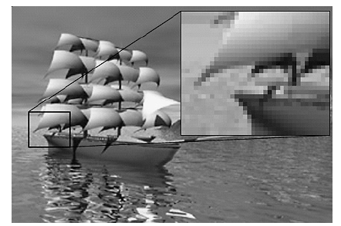
A Bitmap image

Slide 4
Image Data Type
1-Bit Images
A 1-bit image consists of on and off bits only and thus is the simplest type of image.
Each pixel is stored as a single bit (0 or 1). Hence, such an image is also referred to as a binary image.
Monochrome 1-bit images can be satisfactory for pictures containing only simple graphics and text.
Moreover, fax machines use 1-bit data, so in fact 1-bit images are still important even though storage capacities have increased enough to permit the use of imaging that carries more information.

Slide 5

This is the 1-bit monochrome Lena image of size 640×480.
A 640×480 monochrome image requires 38.4 kilobytes (kB) of storage.

Slide 6
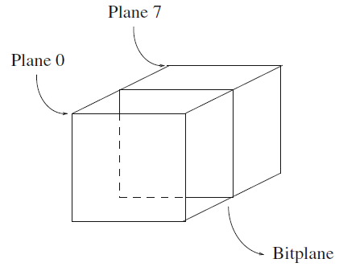
8-Bit Gray-Level Images
In an 8-bit image, each pixel has a gray value between 0 and 255.
Each pixel is represented by a single byte—for example, a dark pixel might have a value of 10, and a bright one might be 230.
We can think of the 8-bit image as a set of 1-bit bitplanes, where each plane consists of a 1-bit representation of the image: a bit is turned on if the image pixel has a nonzero value at that bit level.

Slide 7
Each bitplane can have a value of 0 or 1 at each pixel but, together, all the bitplanes make up a single byte that stores values between 0 and 255
For the least significant bit, the bit value translates to 0 or 1 in the final numeric sum of the binary number. Positional arithmetic implies that for the next, second bit each 0 or 1 makes a contribution of 0 or 2 to the final sum. The next bits stand for 0 or 4, 0 or 8, and so on, up to 0 or 128 for the most significant bit.
Each pixel is usually stored as a byte (a value between 0 and 255), so a 640×480 grayscale image requires 300kB of storage (640×480 = 307,200).

Slide 8
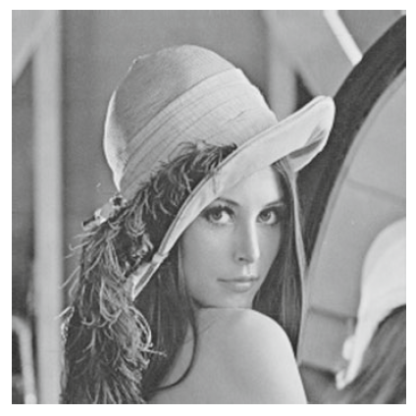
Lena gray-level image

Slide 9
24-Bit Color Images
In a color 24-bit image, each pixel is represented by three bytes, usually representing RGB.
Since each value is in the range 0–255, this format supports 256×256×256, or a total of 16,777,216, possible combined colors.
However, such flexibility does result in a storage penalty: a 640 × 480 24-bit color image would require 921.6kB of storage without any compression.

Slide 10
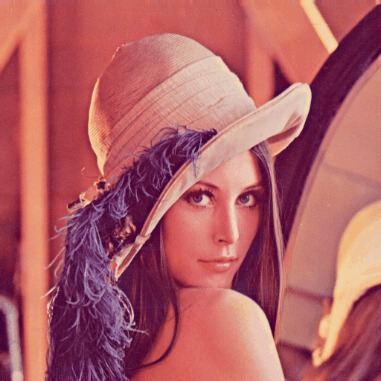

Slide 11
Resolution
Resolution is a measure of how finely a device displays graphics with pixels. It is used by printers, scanners, monitors (TV, computer), mobile devices and cameras.
There are two types ways of measuring resolution:
The amount of (dpi) dots per inch. Printers and scanners work with higher resolutions than computer monitors. Current desktop printers can support 300dpi +, flatbed scanners from 100-3600dpi+. In comparison computer monitors support 72-130 dpi.
ppi (Pixels Per Inch) is a term also used to define the resolution for bitmaps. Bitmap images are resolution-dependent as they contain a fixed number of pixels.
As a result, they can lose detail and appear jagged if they are scaled to high magnifications on screen or if they are printed at a lower resolution than they were created for.

Slide 12
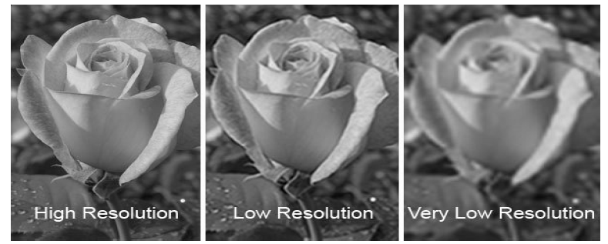
Example of a Bitmap Image at Different Levels of Magnification

Slide 13
Bitmap images contain a fixed number of pixels, usually measured in pixels per inch (ppi). An image with a high resolution contains more, and therefore smaller, pixels than an image of the same printed dimensions with a low resolution.
Example: A one inch by one inch image with a resolution of 72 ppi contains a total of 5184 pixels (72 pixels wide × 72 pixels high = 5184). The same one inch by one inch image with a resolution of 300 ppi would contain a total of 90,000 pixels.

